Slide 1

Hotel Property Management Systems
Team Members:
Venkata Naga Saatvika Kavi
Sai Jaswanth Chinthapatla
Parimala Yerraguntla
YNV Tanmayee
Rithi Veronica Joseph Diraviam Lindon
Prof. Theyab Alhwiti Date: 5/3/24

Slide 2
Introduction
Mid-sized Hotel
PMS are essential in the modern hospitality industry.
Automate and centralize hotel operations.
Improve operational efficiency and guest satisfaction.
Key tool for revenue optimization and competitive advantage.
Support a wide range of hotel operations from reservations to billing.

Slide 3
Importance of PMS in Hospitality
Handle complexities of hotel operations.
Essential for managing customer preferences and market competition.
Provide a strategic framework for operational excellence.
Enable hotels to offer seamless guest experiences.
Support real-time decision-making with data analytics

Slide 4
Core Functionalities of PMS
Online booking and real-time availability tracking.
Comprehensive reservation management.
Seamless check-in/check-out processes.
Efficient channel management across platforms.

Slide 5
Methods
Inventory Control and Guest Services
Real-time monitoring of inventory levels.
Automated ordering and cost control.
Personalized guest experiences and profile management.

Slide 6
Methods
Performance Analytics and Reporting
Customizable dashboards for key performance indicators.
Forecasting tools for occupancy and revenue.
Benchmarking against industry standards.

Slide 7

Entities
Reservations: Tracks all reservation details, special requests, and linked guest information.
Rooms: Records data on all hotel rooms, including status, type, and amenities.
Room Types: Categorizes rooms to streamline booking processes and rate applications.
Billing: Documents all charges and payments for services during a guest’s stay.
Inventory: Oversees hotel supplies, ensuring availability and timely restocking.
Guests: Manages guest profiles with contact info, preferences, and booking history.
Room Assignment: Connects guests to their specific rooms and stay durations.
Payments: Manages payment transactions and methods, ensuring financial accuracy.
Reports: Generates operational and financial reports for strategic analysis.

Slide 8
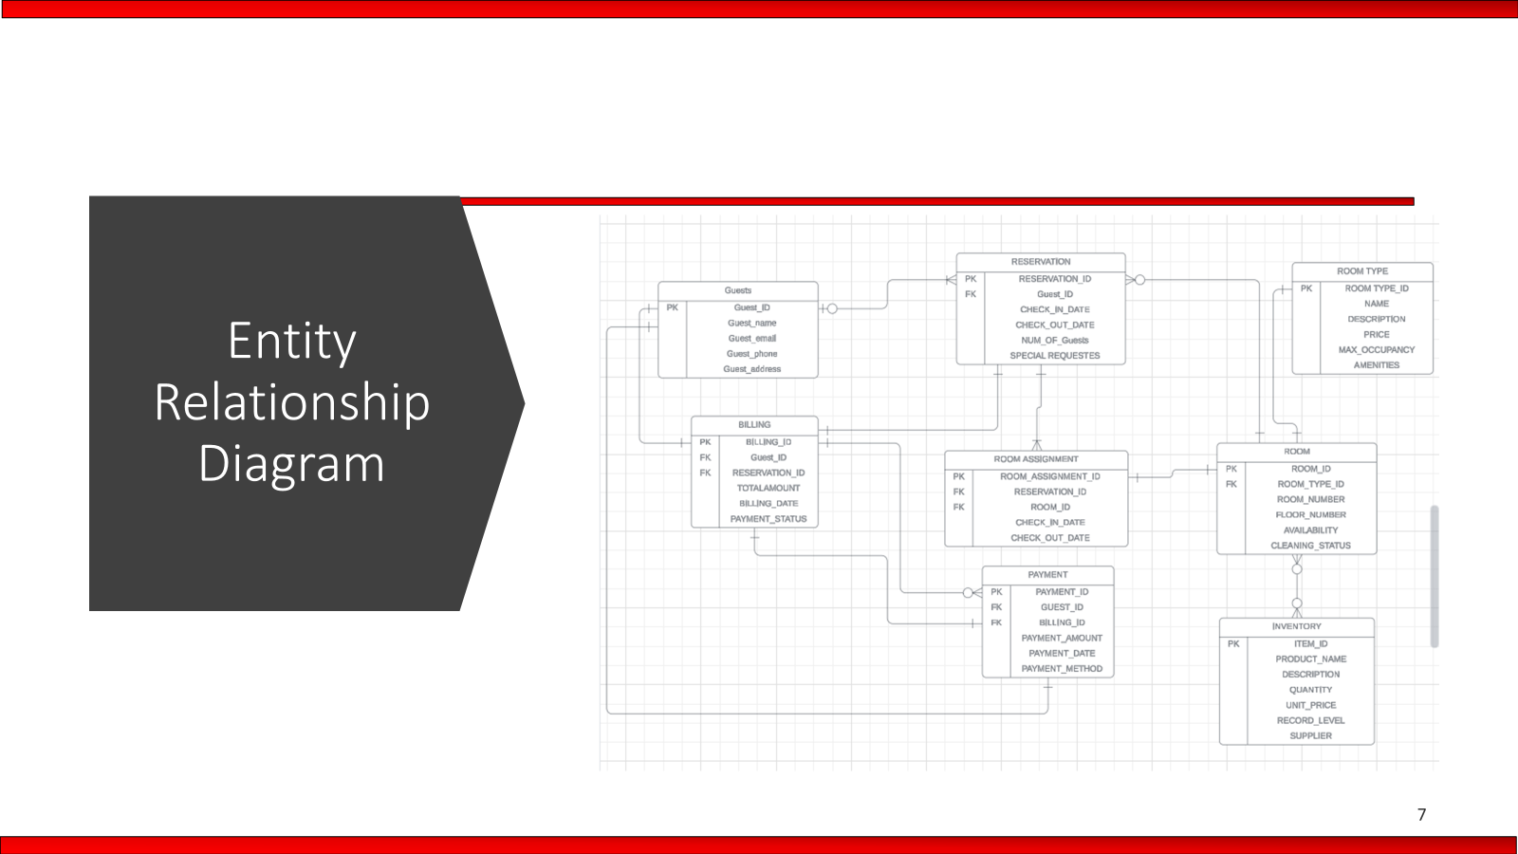

Slide 9
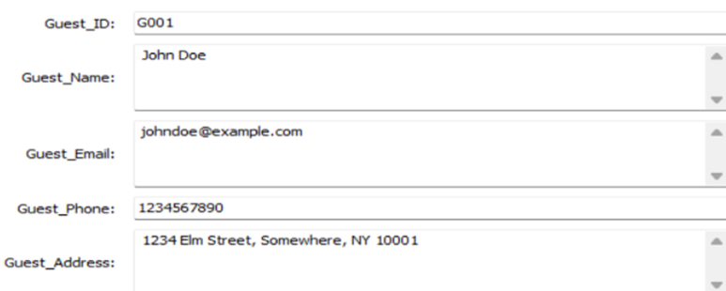
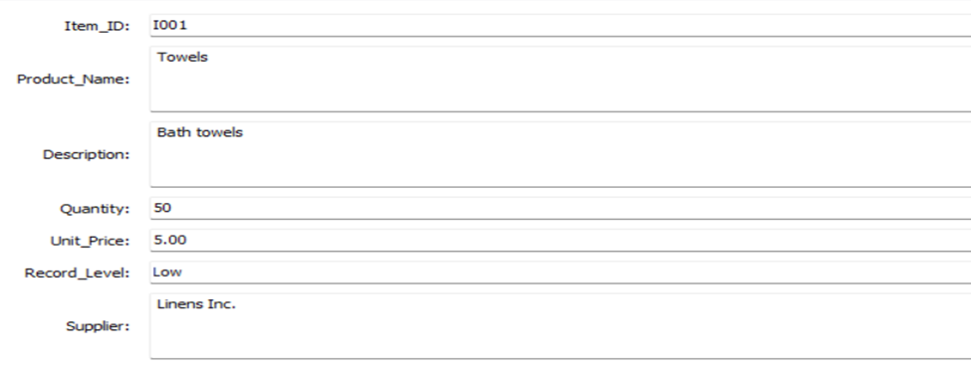
User Interface
Create a form items/guests and the values can be modified or entered dynamically.

Slide 10
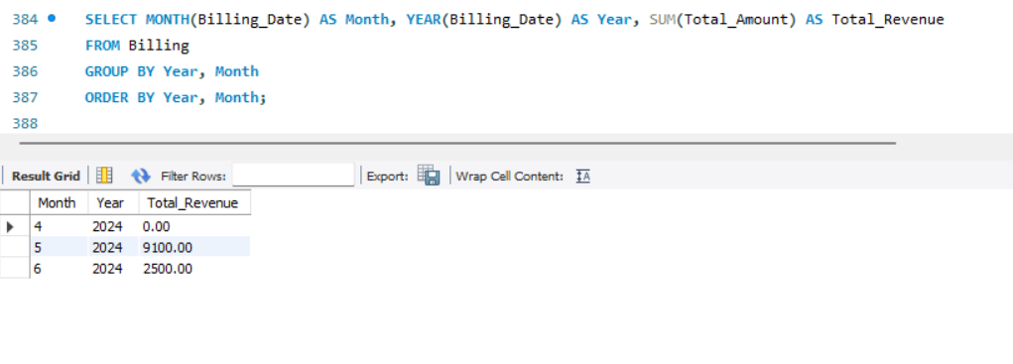
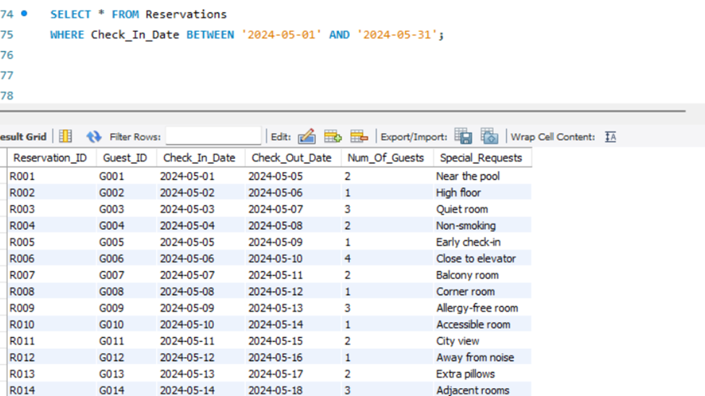
Reports
Revenue report for year 2024
Reservations between date range of 05-01-24 and 05-31-24

Slide 11
Results/Solutions
Effective PMS Implementation
Demonstrated improvements in operational efficiency.
Enhanced guest satisfaction and retention.
Revenue growth through optimized resource management.
Improved competitive advantage in the hospitality market.
Long-term sustainability and expansion

Slide 12
Discussion
Summary of PMS Benefits
Central to modern hotel management.
Enable hotels to navigate complex market dynamics.
Essential for enhancing operational efficiency and guest relations.

Slide 13
Discussion
Future of PMS in Hospitality
Trends in technology and guest management.
The growing importance of data analytics in hospitality.
Future challenges and opportunities for PMS development.

Slide 14
Conclusion
PMS as a transformative tool for the hospitality industry.
Critical for achieving operational excellence and superior guest experience.
Continuous innovation and adaptation are key to future success.

Slide 15
THANK YOU

